Slide 1
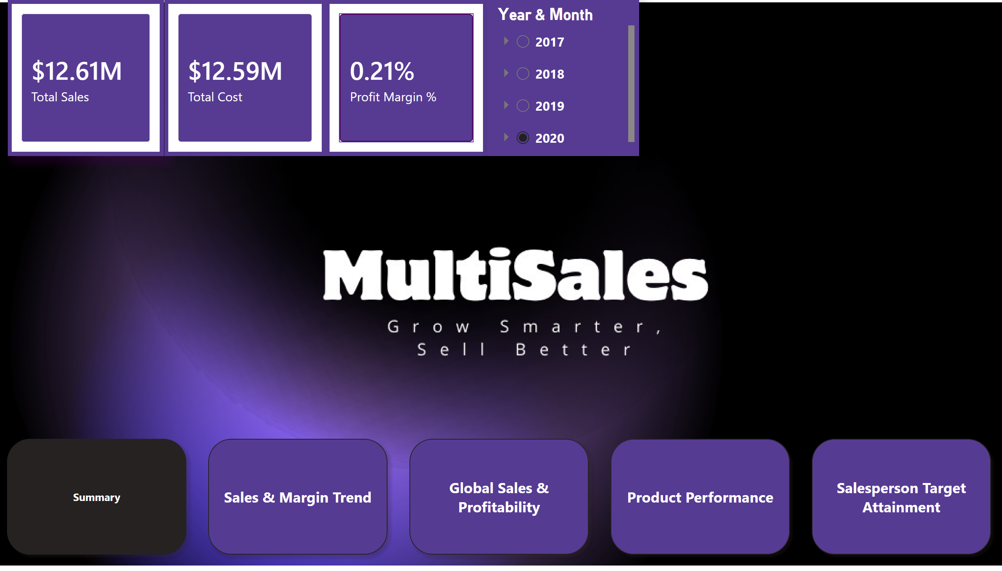
Summary
Notes:
pageNavigator
No alt text provided
cardVisual
No alt text provided
cardVisual
No alt text provided
cardVisual
No alt text provided
slicer
No alt text provided

Slide 2
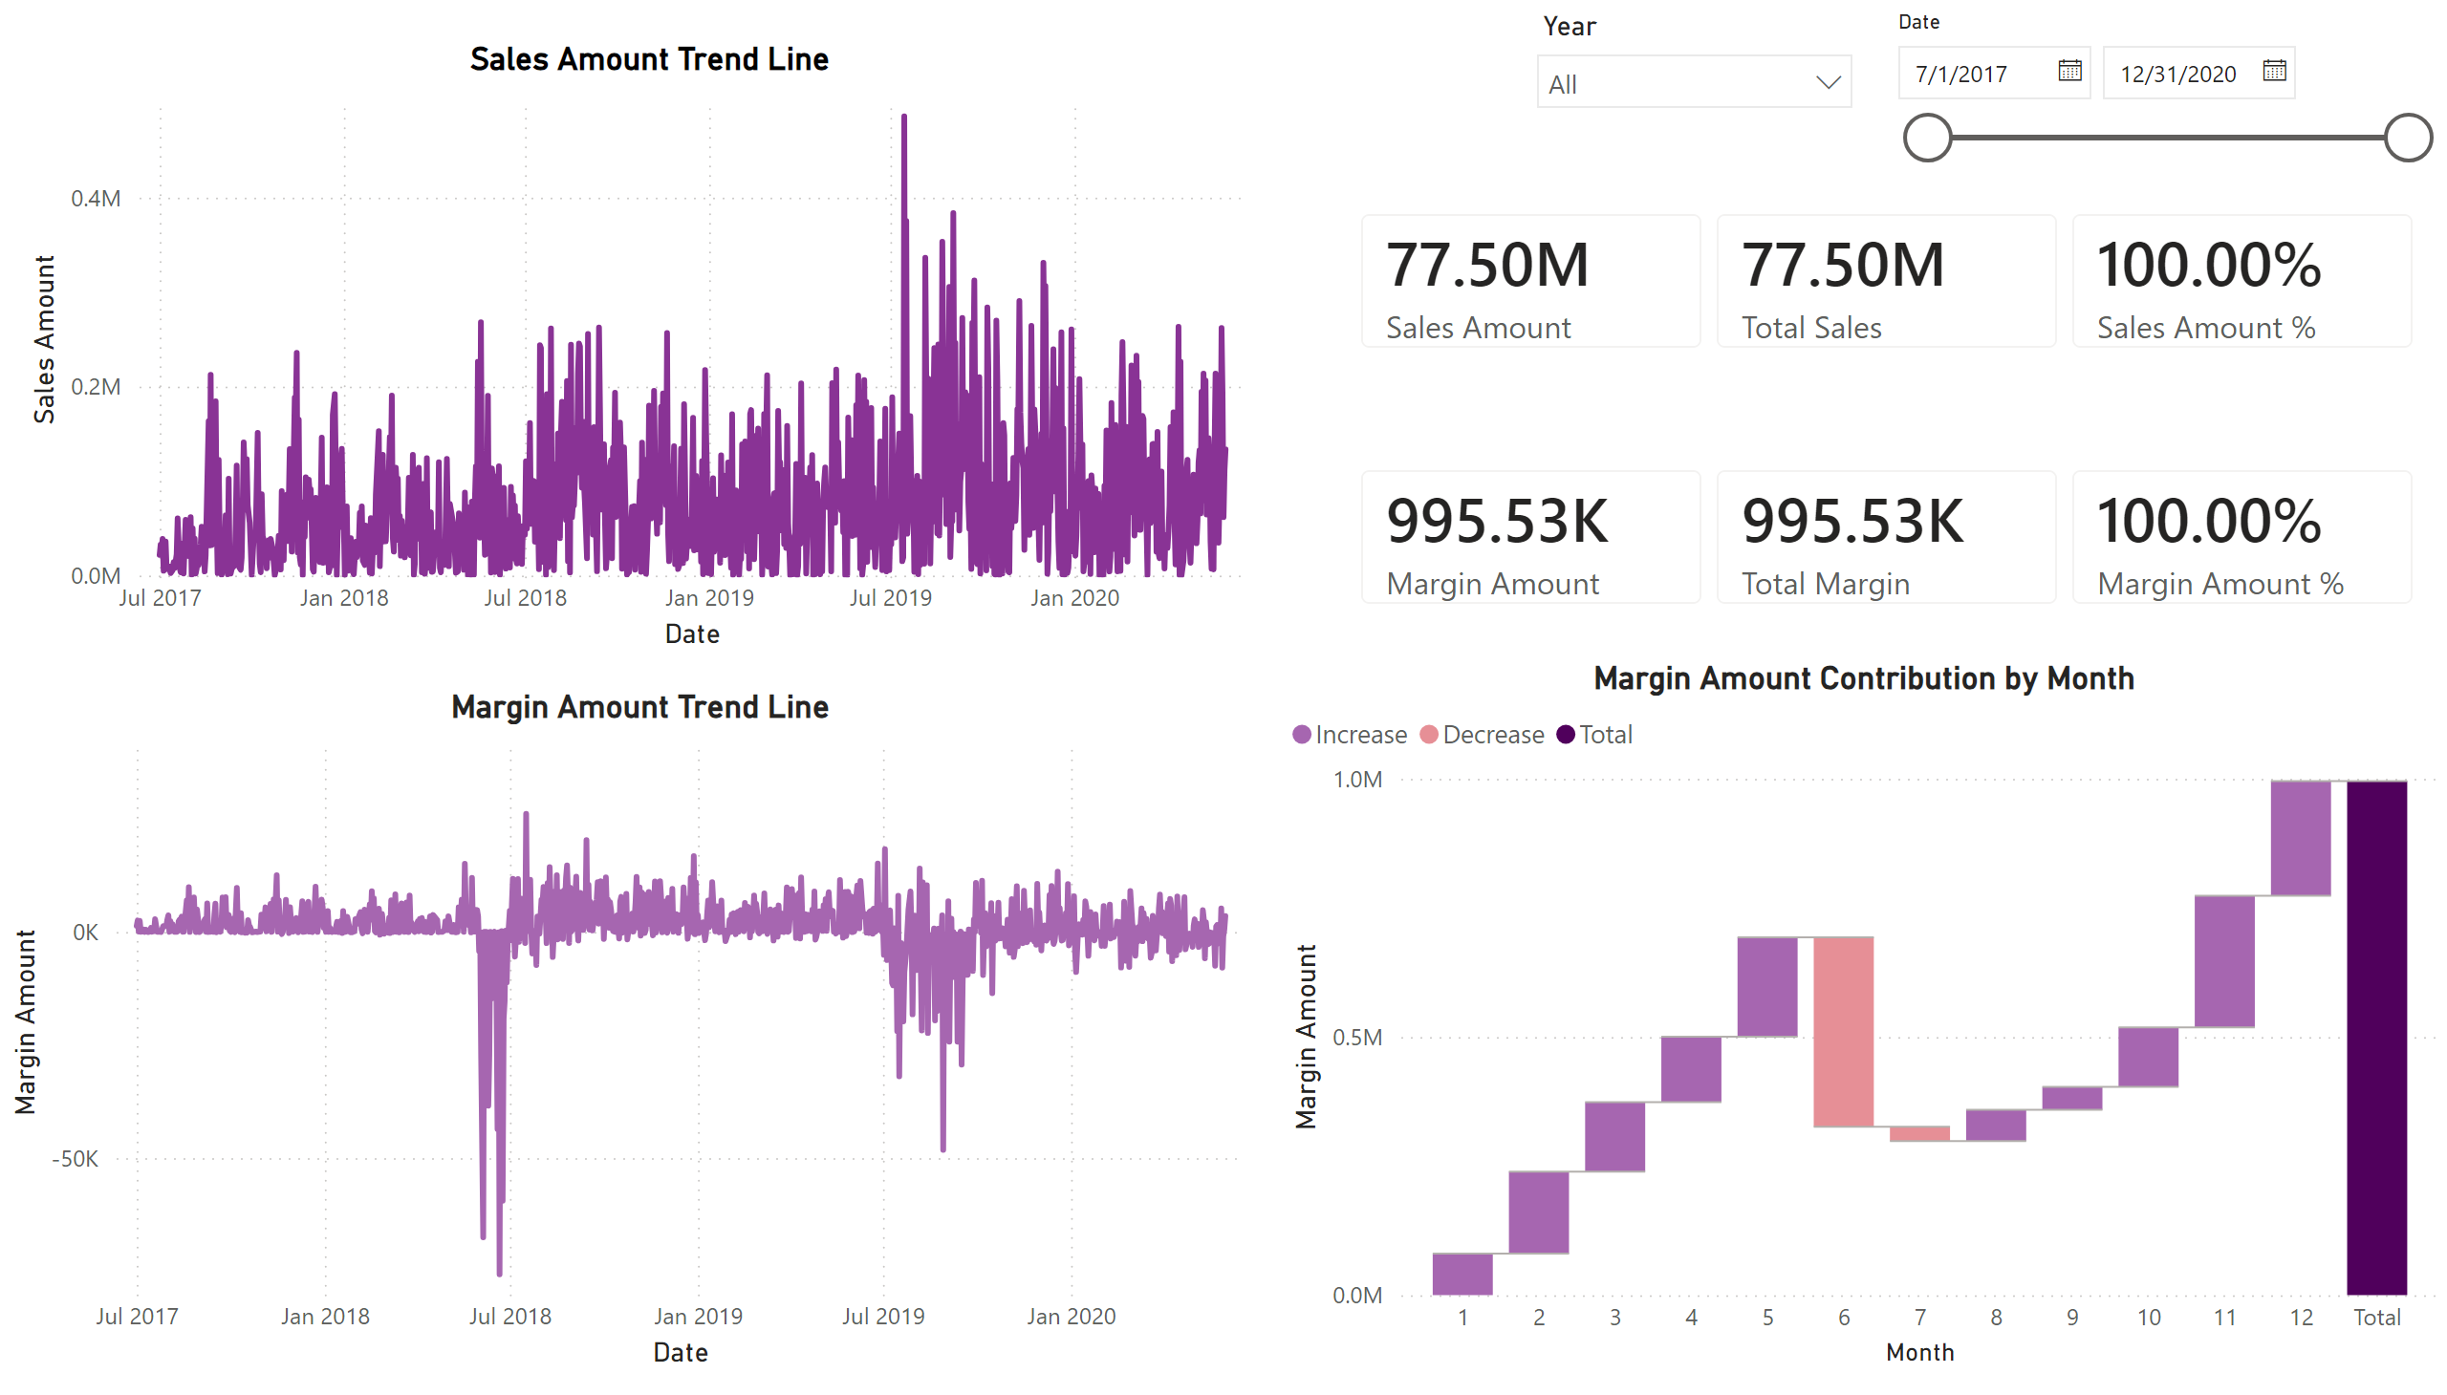
Sales & Margin Trend
Notes:
cardVisual
No alt text provided
Margin Amount Trend Line
No alt text provided
Margin Amount Contribution by Month
No alt text provided
Sales Amount Trend Line
No alt text provided
slicer
No alt text provided
slicer
No alt text provided
cardVisual
No alt text provided

Slide 3
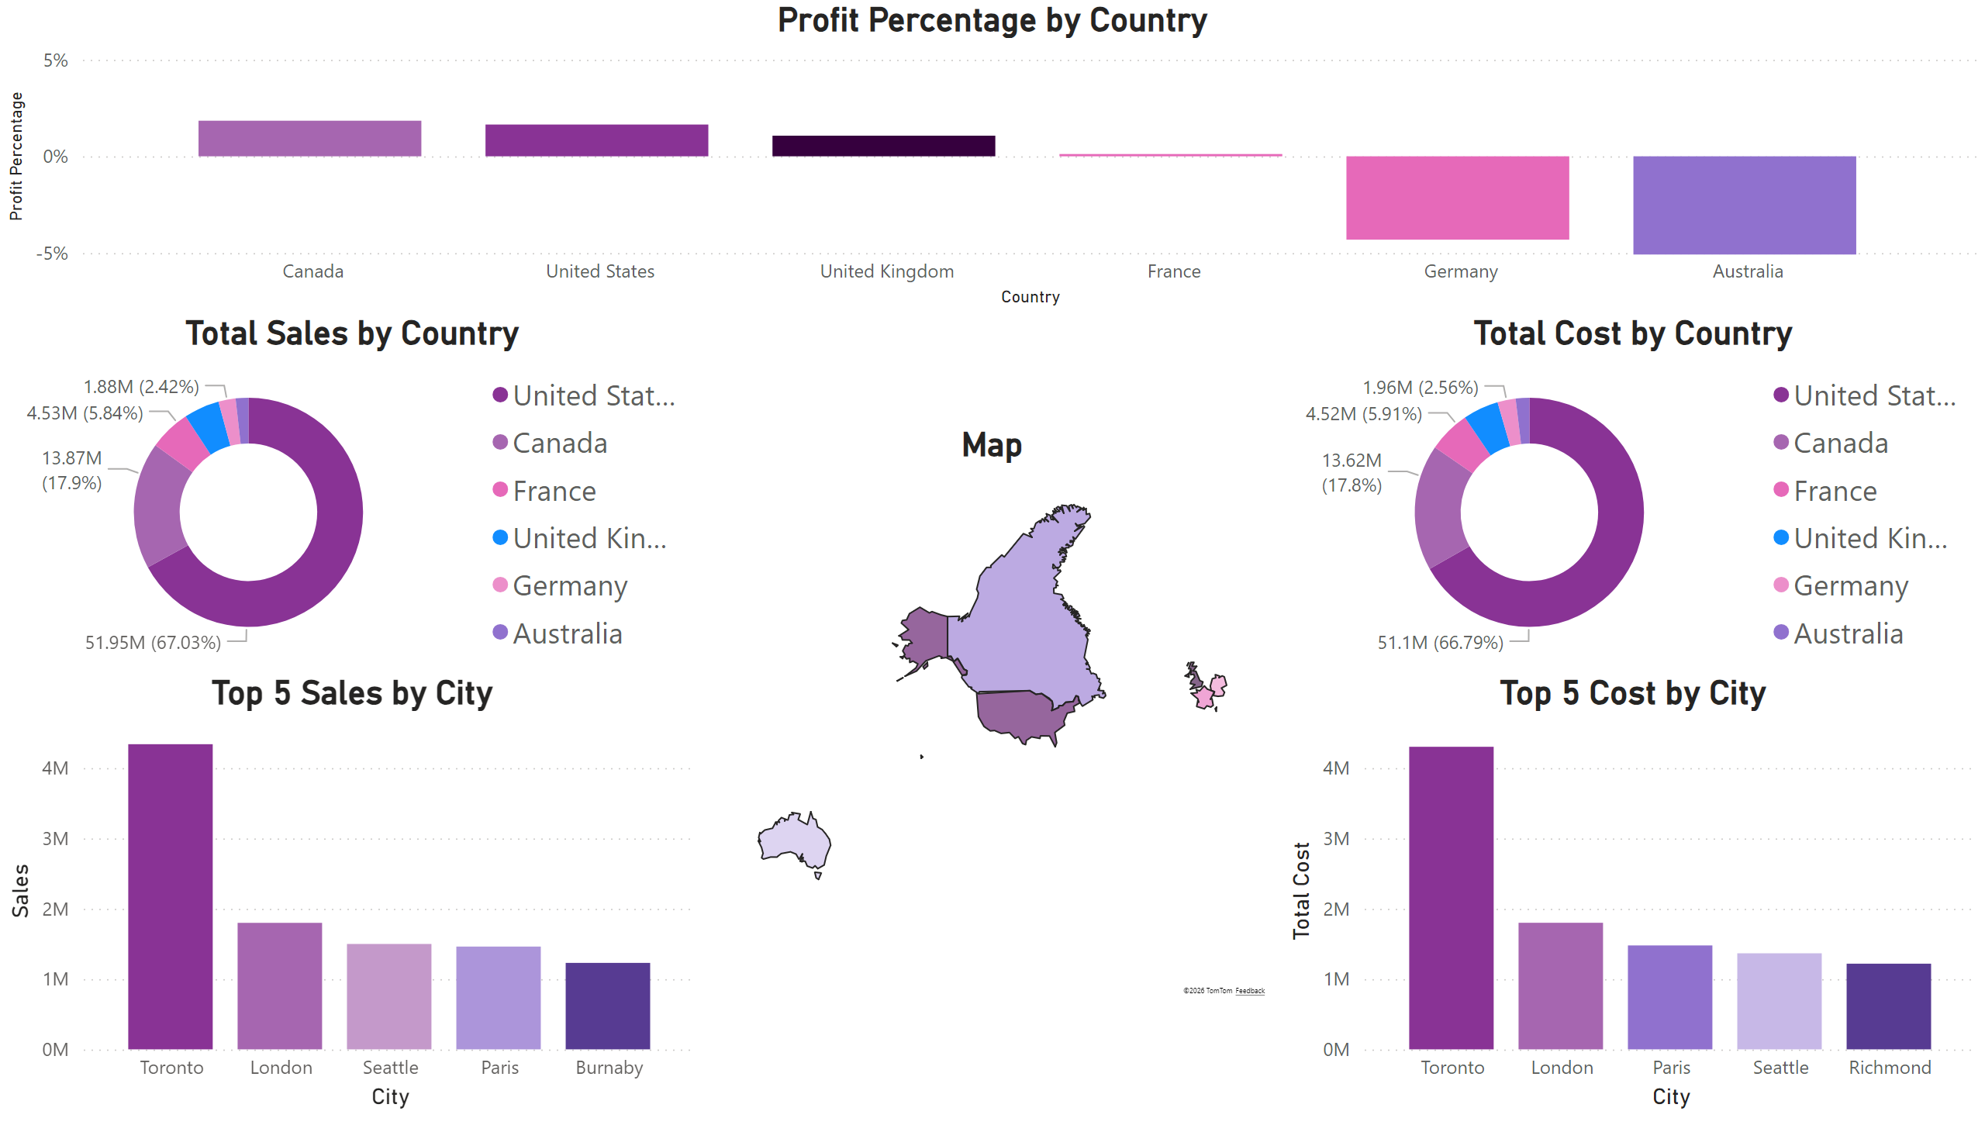
Global Sales & Profitability
Notes:
Profit Percentage by Country
No alt text provided
Top 5 Cost by City
No alt text provided
Total Cost by Country
No alt text provided
Top 5 Sales by City
No alt text provided
Total Sales by Country
No alt text provided
Map
No alt text provided

Slide 4
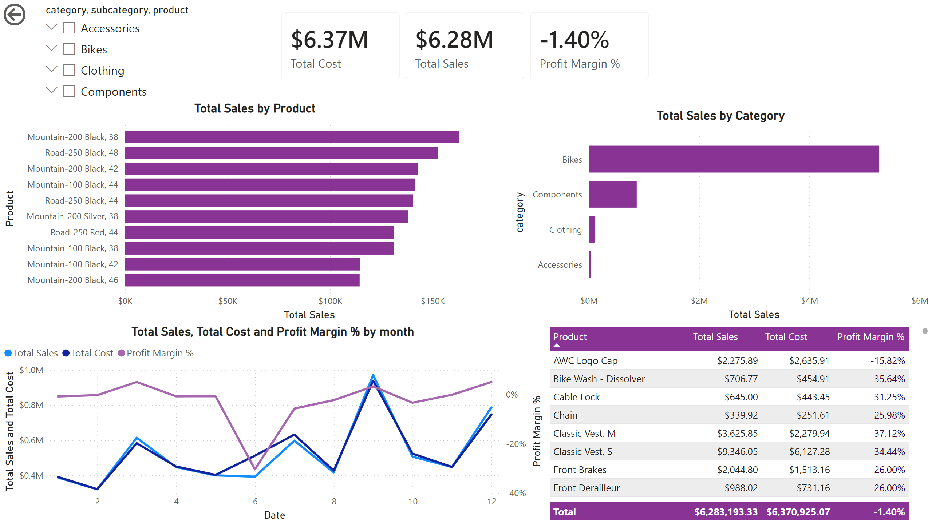
Product Performance
Notes:
cardVisual
No alt text provided
slicer
No alt text provided
actionButton
No alt text provided
clusteredBarChart
No alt text provided
Total Sales by Category
No alt text provided
lineChart
No alt text provided
tableEx
No alt text provided

Slide 5
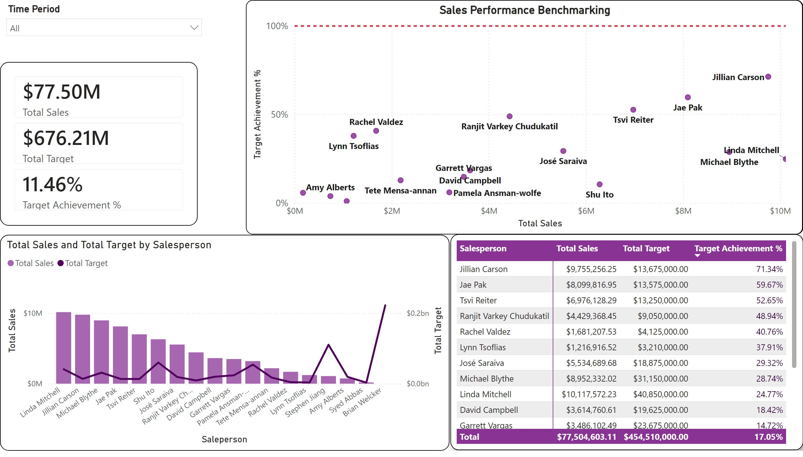
Salesperson Target Attainment
Notes:
cardVisual
No alt text provided
Sales Performance Benchmarking
No alt text provided
slicer
No alt text provided
Sales Performance Benchmarking
No alt text provided
Total Sales and Total Target by Salesperson
No alt text provided
pivotTable
No alt text provided

